Slide 1
Our project name Hall Management System Group-10

Slide 2
Hello! We are
Name: 1.Tanzila Akter ID:343
2.Sayeda Parvin :358
3.Shifati Rabbi :371

Slide 3
What !! We use in our project…
1
2
In our project have two part frontend and backend
In Frontend we use html, css, bootstrap, JavaScript
3
In backend we use database(dbsqlite3), Django, rest-framework

Slide 4
Here is our Frontend start…

Slide 5
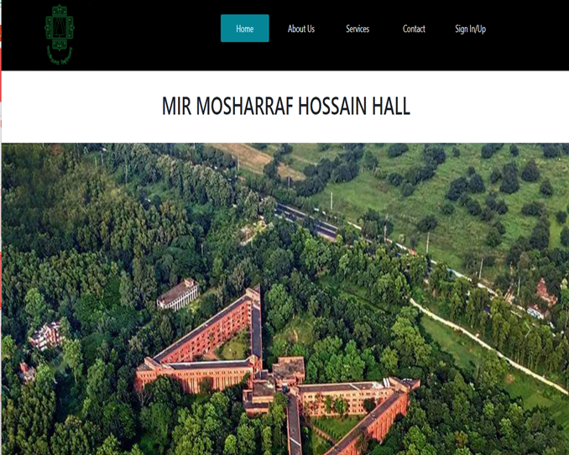
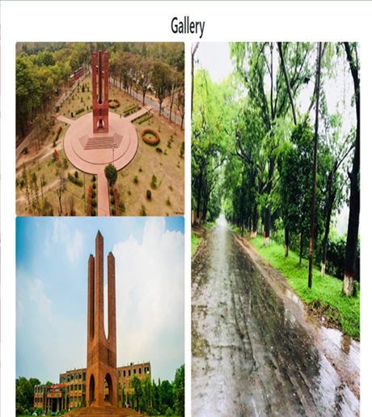
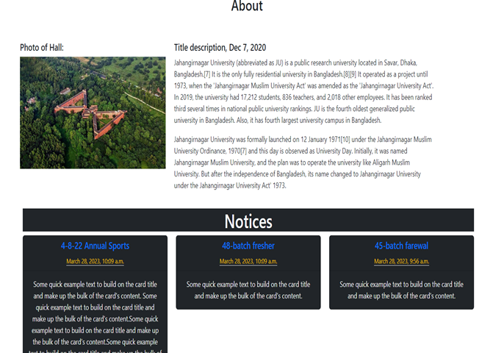
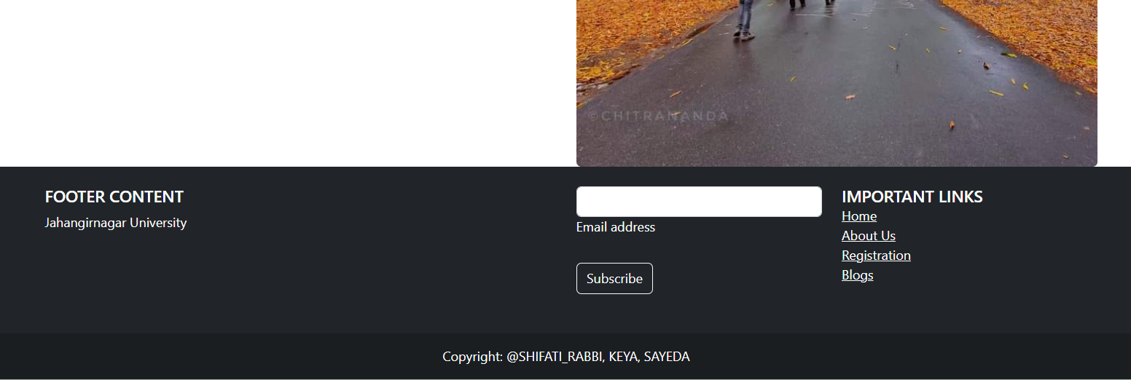
Here is the home page of our project

Slide 6
Frontend page function…
Home page of frontend..
Other page of frontend..
About Us page : we give a description of hall management teacher in this page.
Student and Provost page: Give student and provost information.
SingIn/SignUp: In sign in page- student, admin, staff can login in the project. They can reset password
In SignUp new student can register himself/herself with the information(name, username, email, session, address, dept name, bed number)
Top of the page we use a drop-down menu with the option( Home, About Us, Services, Contact, Sign In/Up)
In the Page hero section we add a slider of hall photos
We give a description of hall in page figure section
We also add notice part about the hall
Finally add a gallery and footer

Slide 7
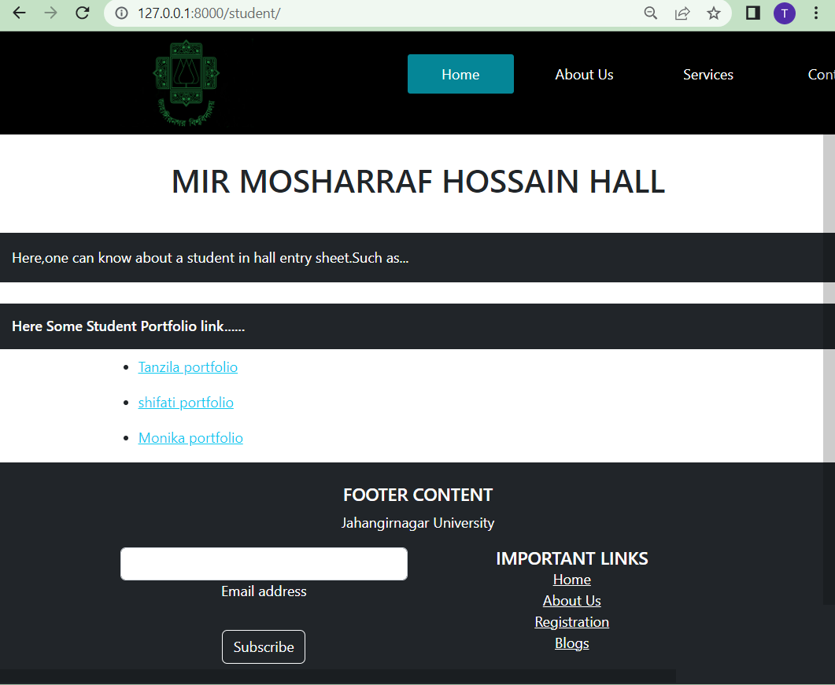
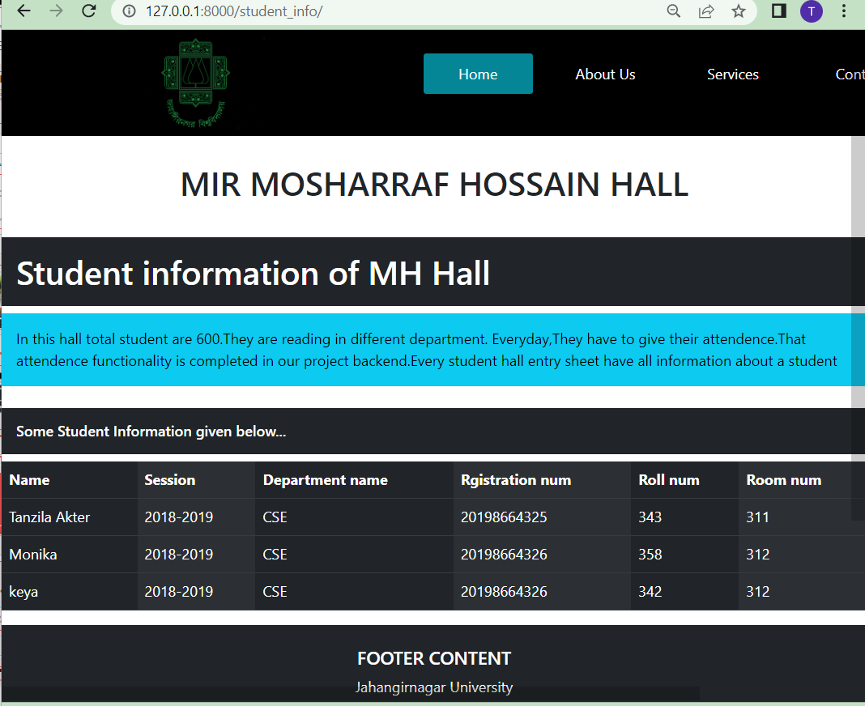
Here is the student, student information page…….

Slide 8
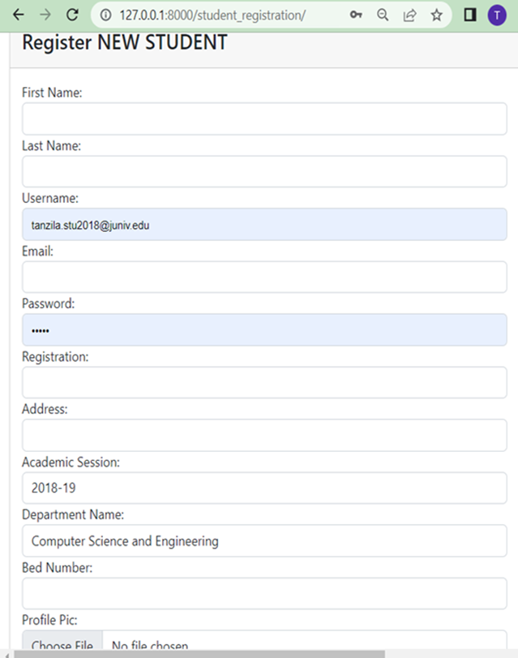
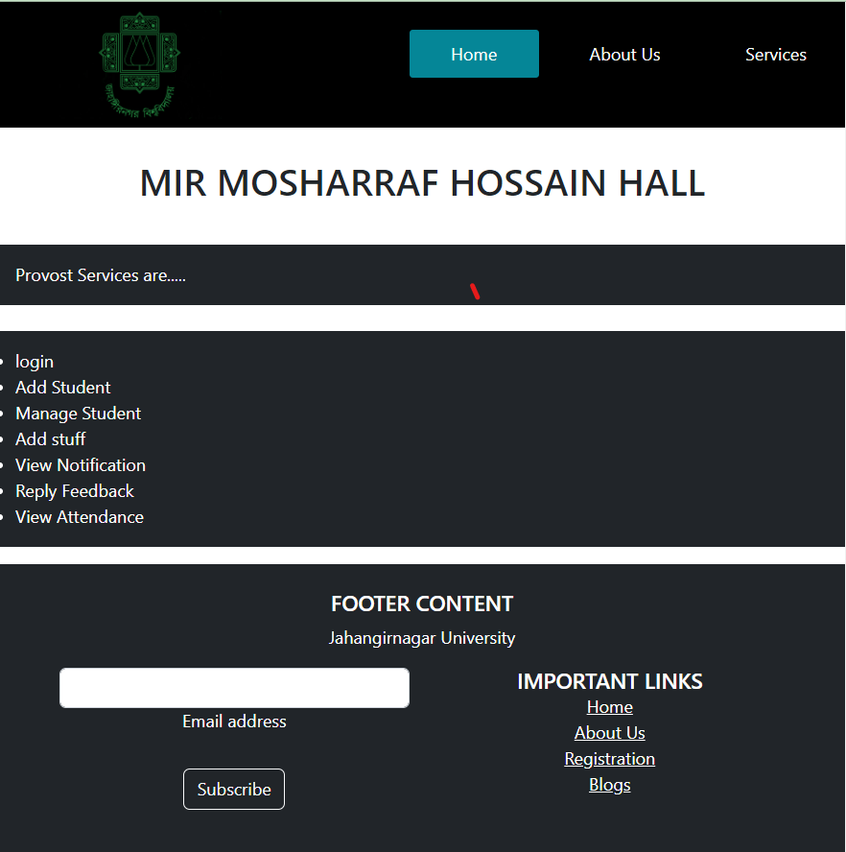
Here is registration page and service page, with the help of this page one student can register and in service page we give a provost-service list

Slide 9
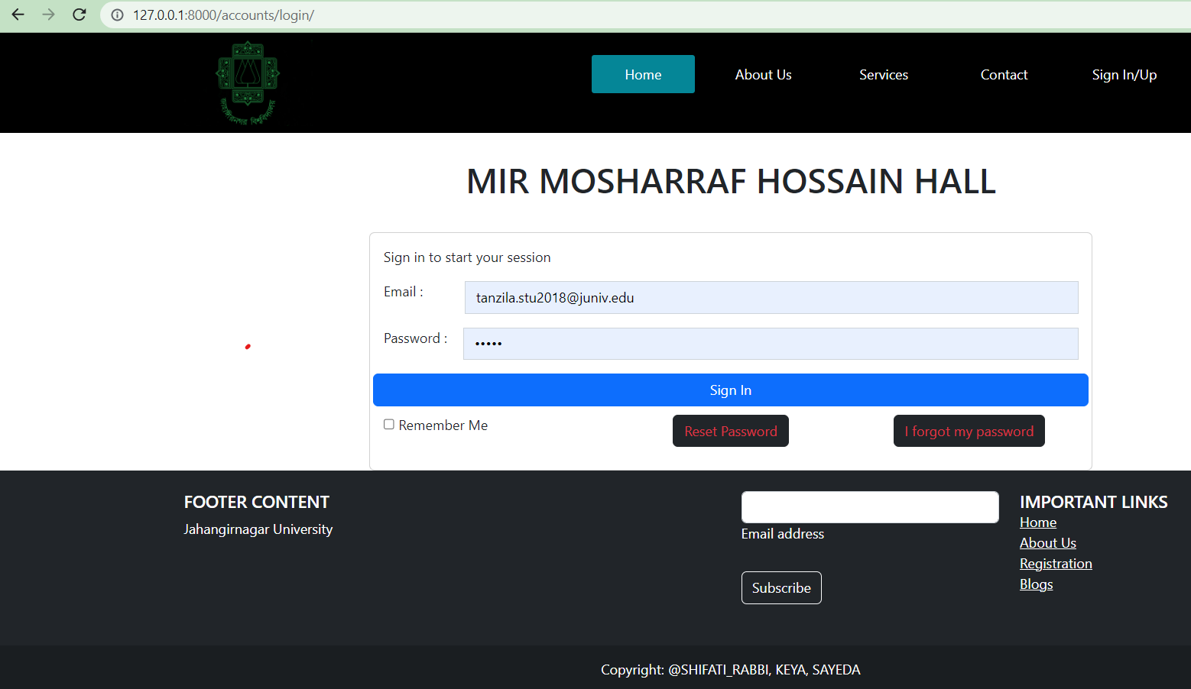
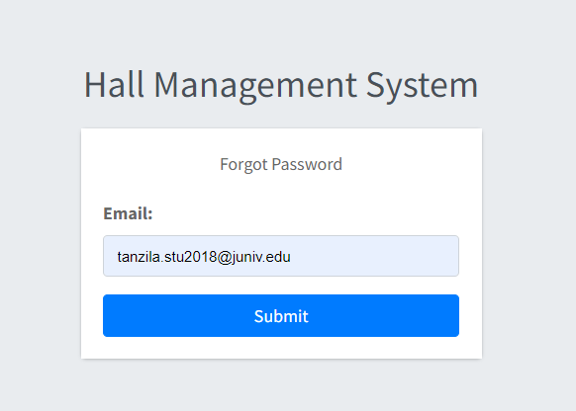
In sign in page,we give a functionality that helps a user to reset their password if they forget throw send a password reset email.

Slide 10
Here is our Backend start…

Slide 11
In backend part We will talk about this first…
1
our project have 3 actor-
1.student
2.Staff
3. Admin
Those Actor have different activism..

Slide 12
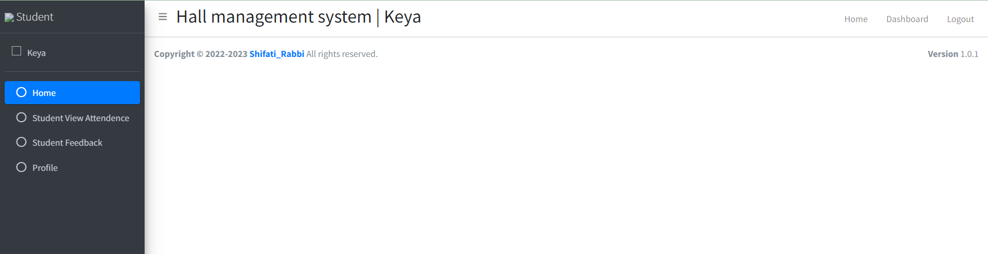
Login as Student
When a person login as a student, student can view attendance , can see his/her profile, send feedback. Also, Student can logout.

Slide 13
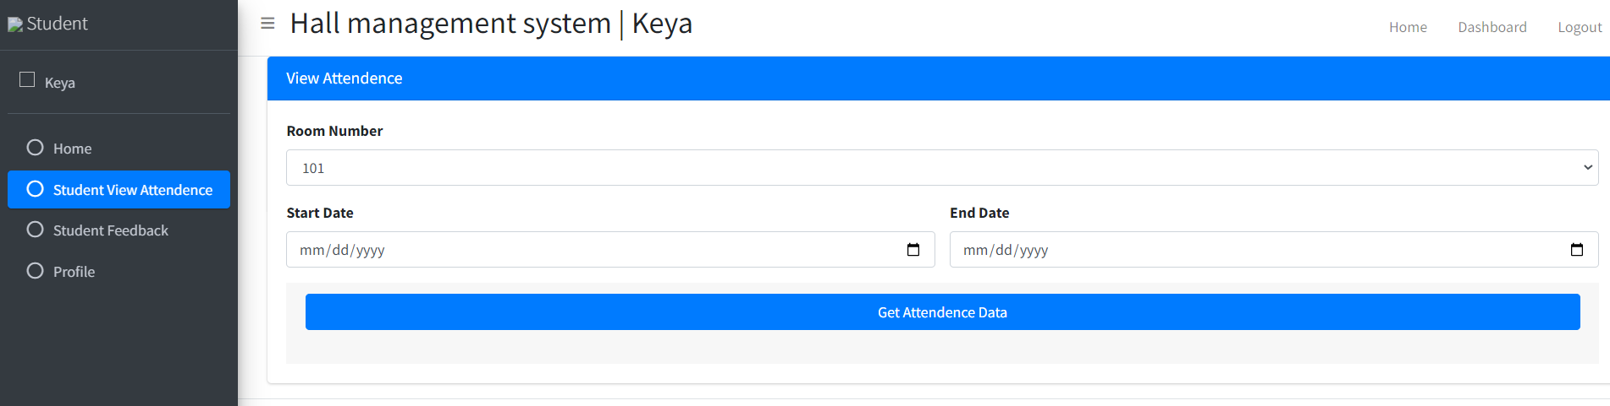
Login as Student(cont..)
In Student View Attendance : Student can enter room number and can give start Date and End Date of his/her existence in this room

Slide 14
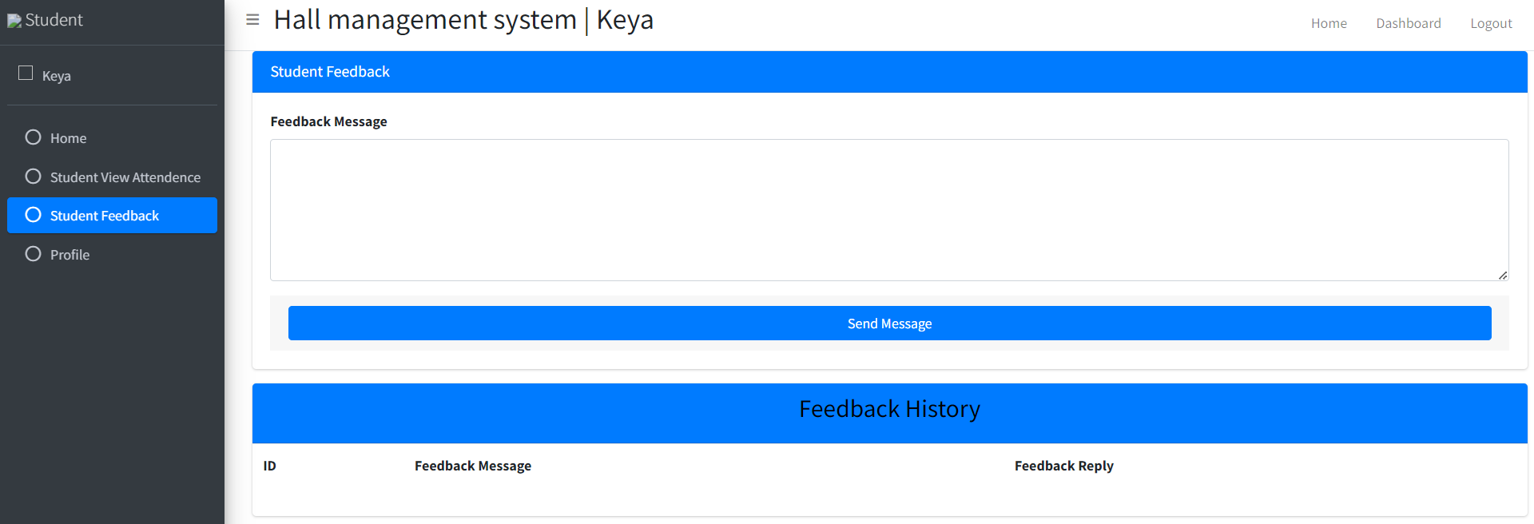
Login as Student(cont..)
In Student Feedback : Student can give feedback message and send them to staff. Also, Student can see feedback history such as feedback id, feedback message , feedback reply

Slide 15
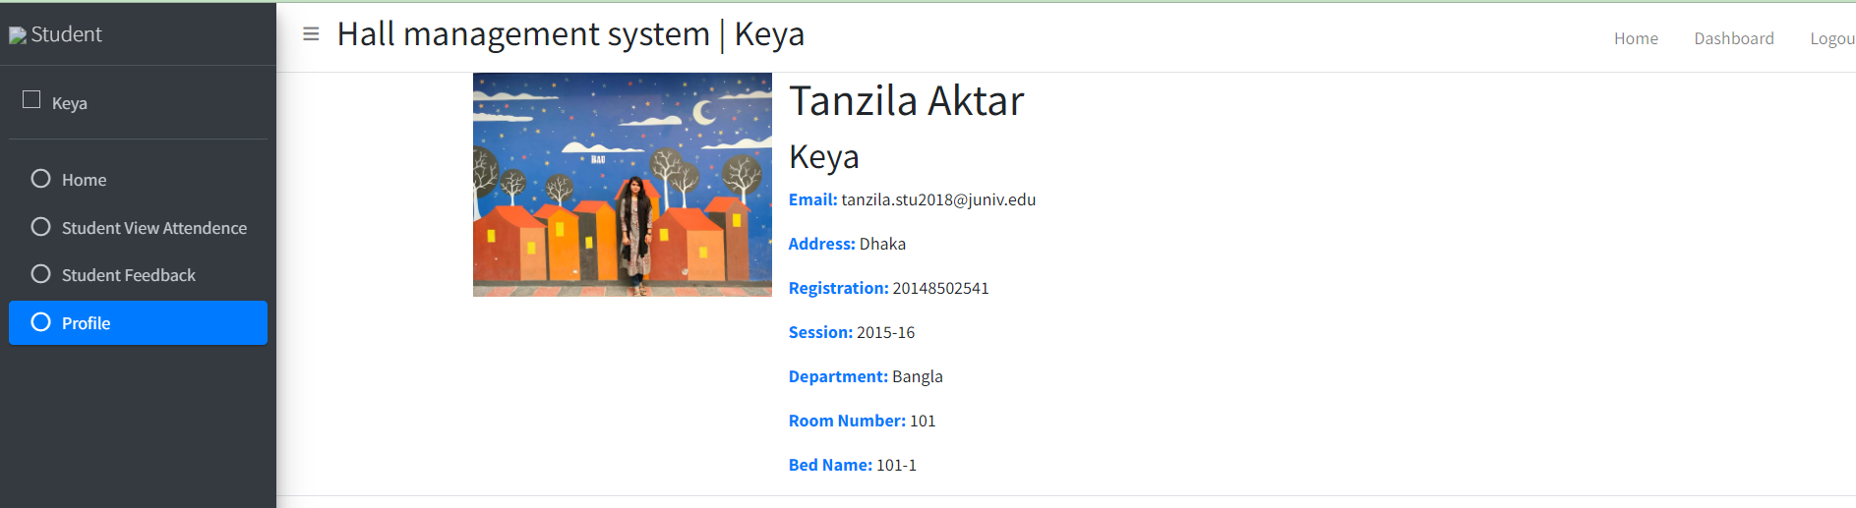
Login as Student (cont..)
In Profile Section: Student can see her/his profile details

Slide 16
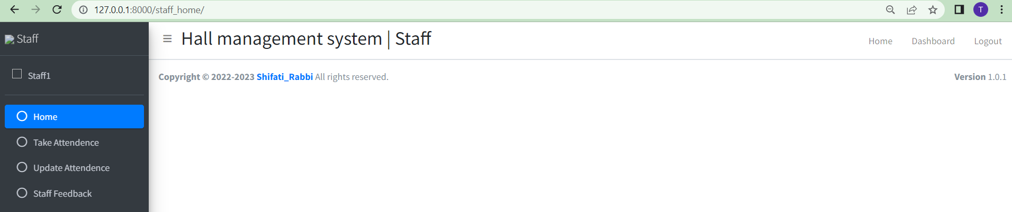
Login as Staff..
In home page, Staff can logout and go to home page

Slide 17
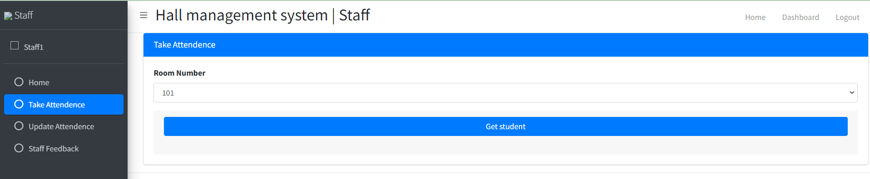
Login as Staff(cont..)
Staff can take attendance with a Room Number information and save the record in database

Slide 18
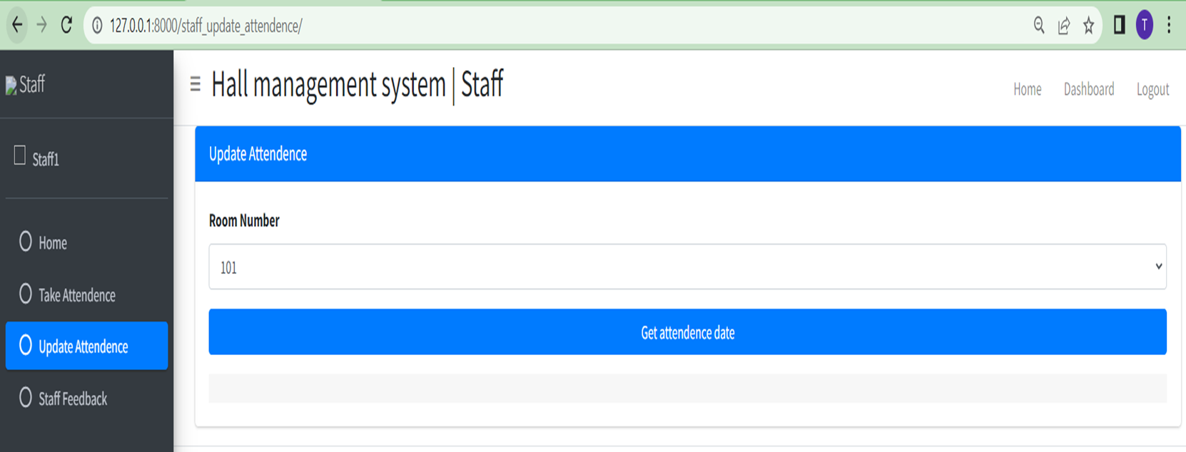
Login as Staff(cont..)
Staff can update attendance .If any date is taken wrong then he can update that and save them in database.

Slide 19
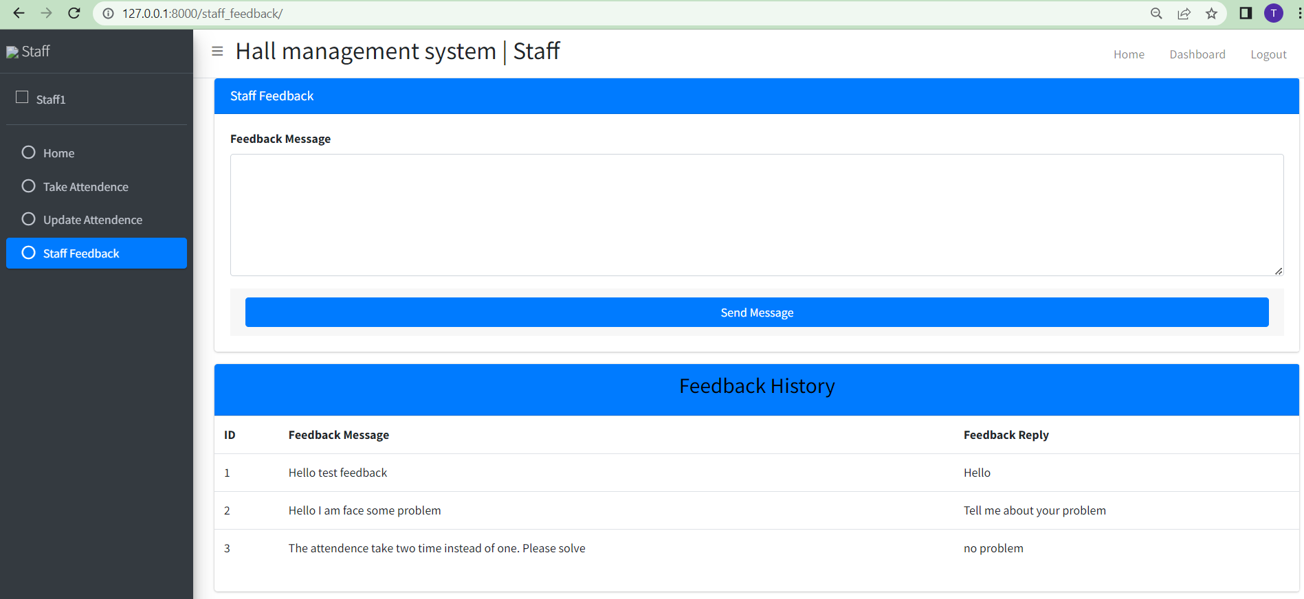
Login as Staff(cont..)
Staff can give feedback massage and can see feedback reply of students, his feedback message in Feedback history.

Slide 20
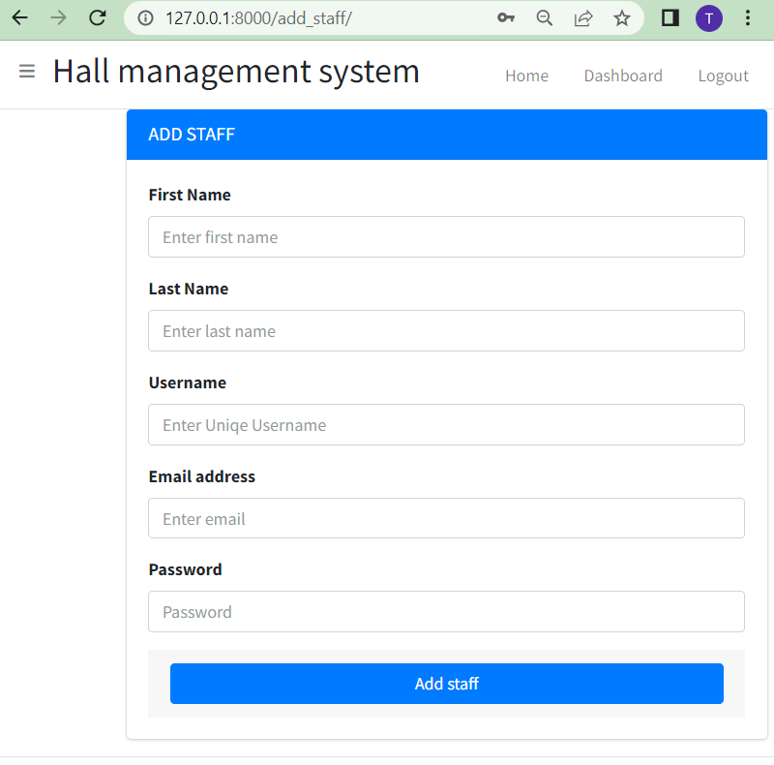
Login as Admin………
In Add staff ,new staff can add by giving her/his name, username, email, password
Admin function-
Add staff
Manage staff
Add Student
Manage Student
Add Room
Manage Room
Add Bed
Mange Bed
Add Department
Manage Department
Add session
Manage Session
View Attendance
Staff Feedback
Student feedback
Create Notice
Manage Notice

Slide 21
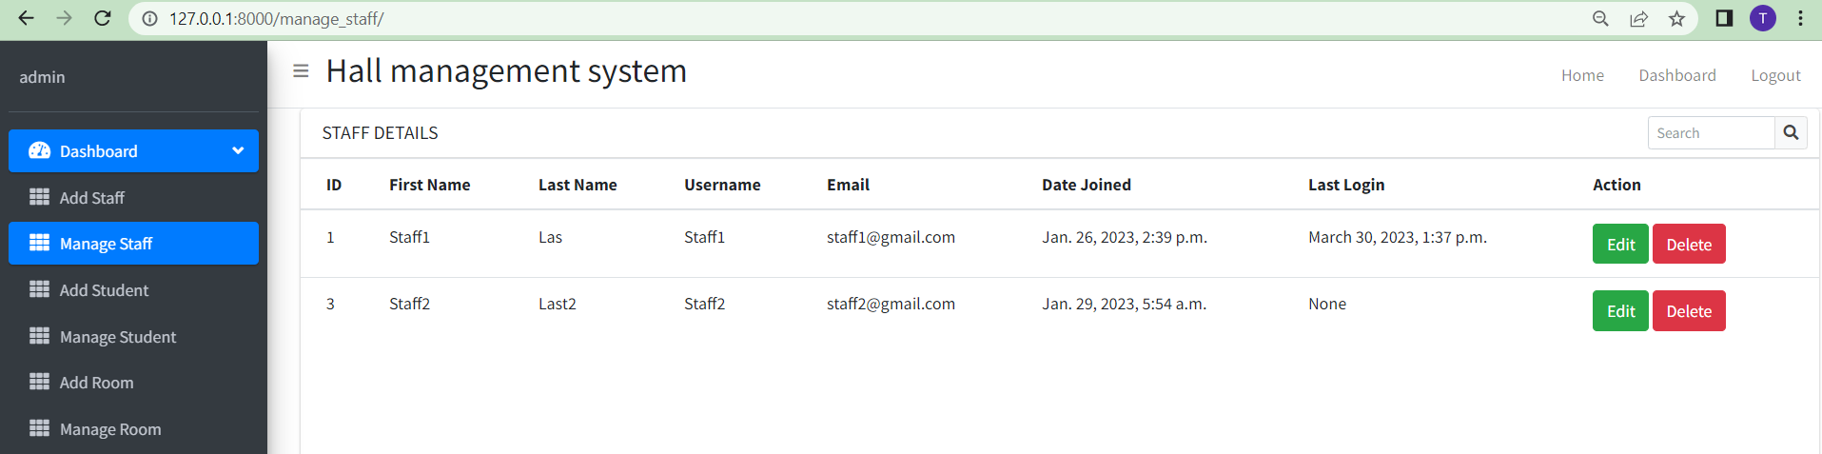
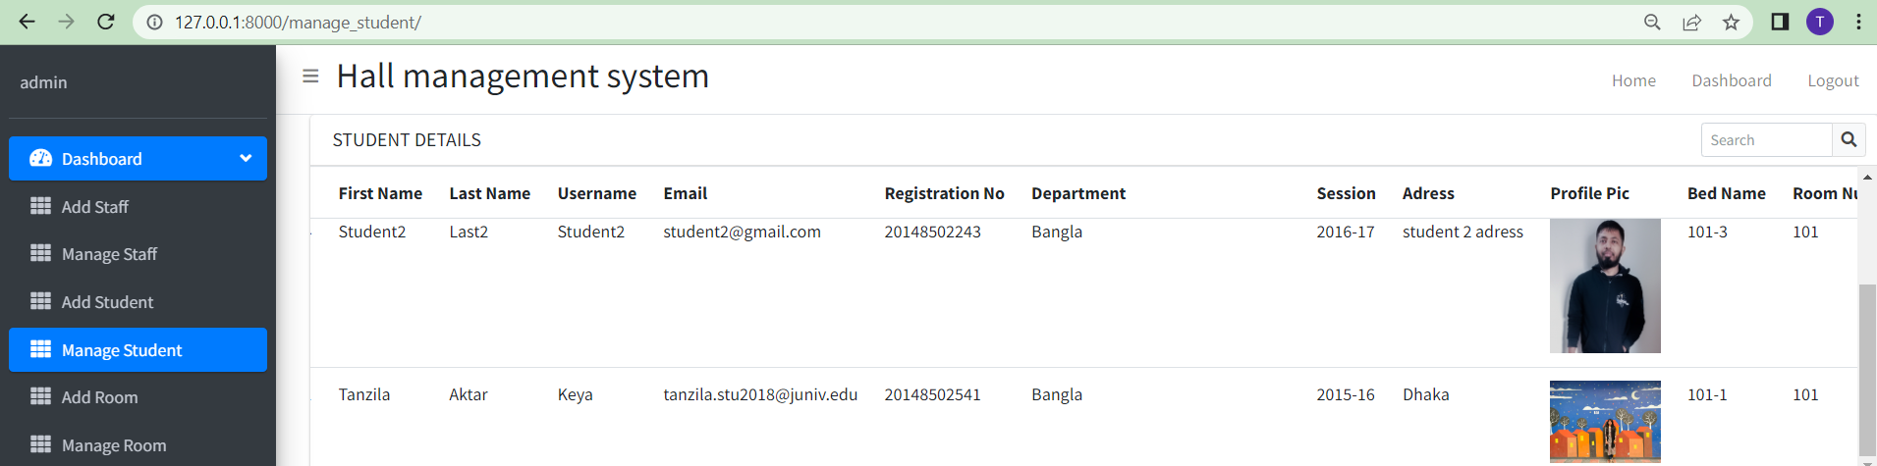
Login as Admin(cont..)
Admin can manage a staff and student. From those admin can know about the details of student ,
staff and can edit ,remove both staff and student.

Slide 22
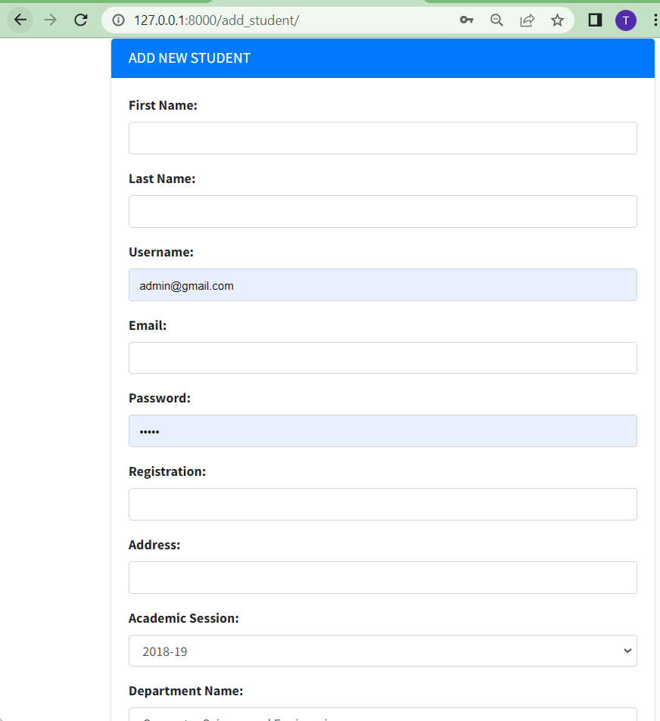
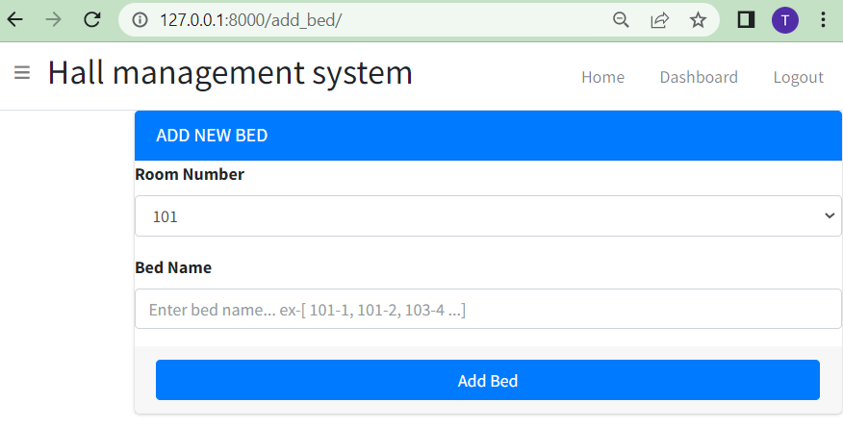
Login as Admin(cont..)
Admin can Add Student with student name, username, email, pass, registration, session, dept ,bed num and picture. Admin also can add new bed in a room(4 bed room will become 5 bed)

Slide 23
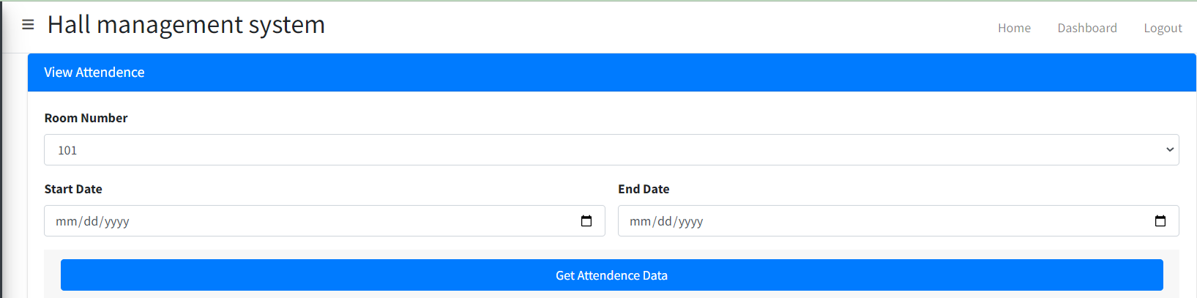
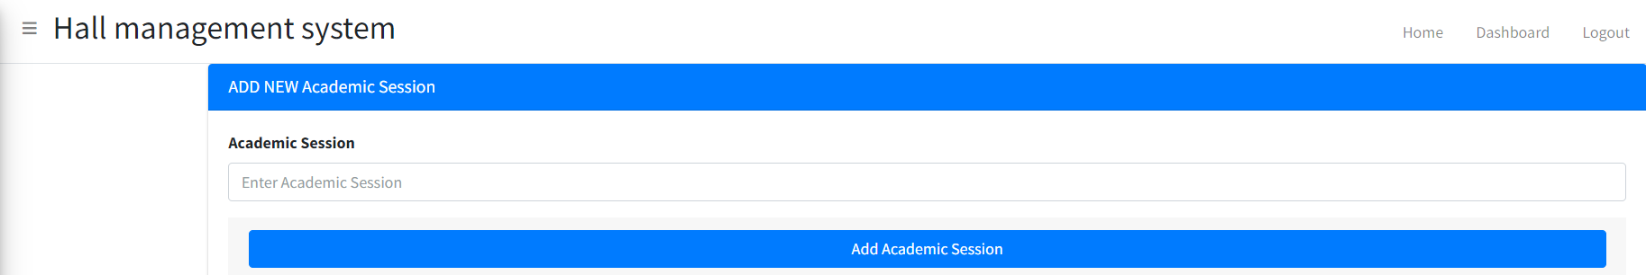
Login as Admin (cont..)
Admin can view attendance of a student room wise from a student entering the room to a student leave the room.
Admin can add Session when a new batch academic year started

Slide 24
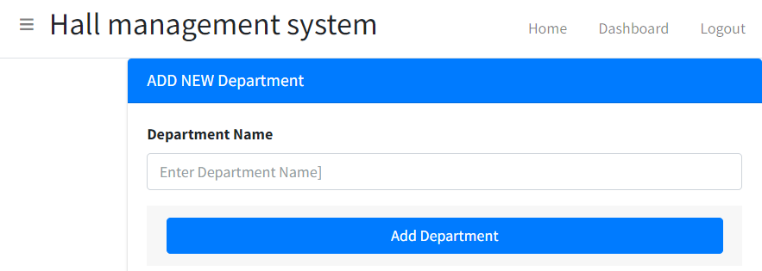
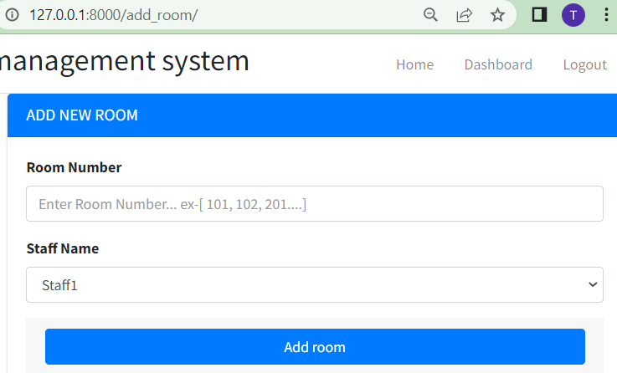
Login as Admin(cont..)
1. Admin can Add department when university open a new department. As ju open remote sensing department.
2. admin can add room such as new floor create for solving shortest problem of sit.

Slide 25
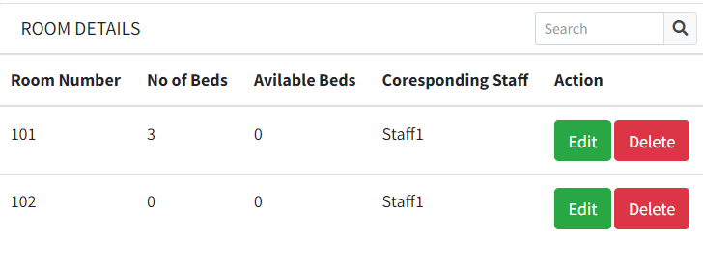
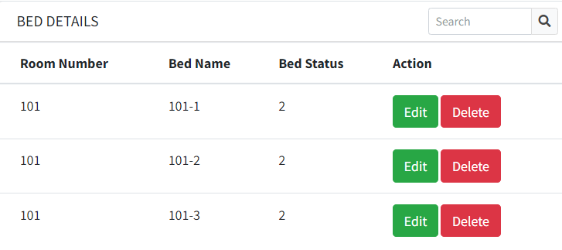
Login as Admin(cont..)
1. Admin can manage room by saving the record of available bed and no of bed under a corresponding staff. Admin can edit available bed, no of bed when any student give clearance of his sit available beds are increasing. When a bed is added for solving shortest of sit then
Increasing no of bed
2. Admin can manage bed. A room have 4/5 bed, admin can add more bed for completing allotment of student. Admin can save the record of bed status for allotting student in a room. If a room bed status is 4/5, admin can allot 4/5 student in that room.

Slide 26
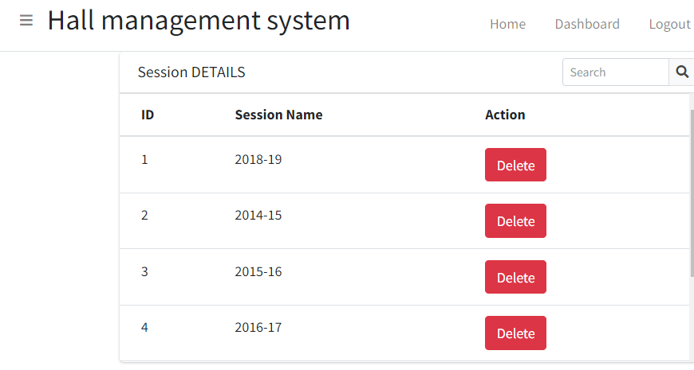
Login as Admin(cont..)
Admin can manage a session when a session honors/masters is completed, session is deleted by admin.
Admin can manage staff by edit and remove a staff. when a staff is added by exchanging another staff then staff information can edit.

Slide 27
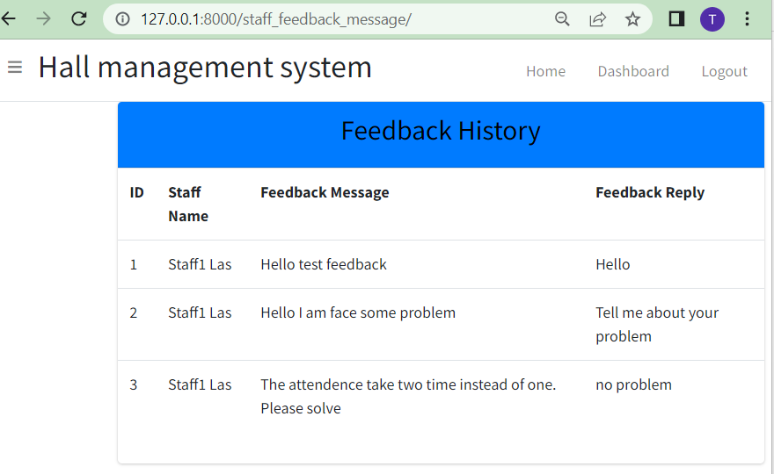
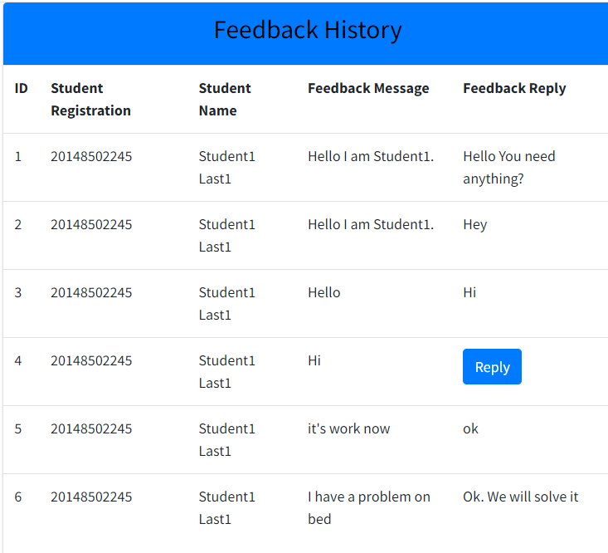
Login as Admin(cont..)
Admin can see student and staff feedback from that admin can know how staff maintain her responsibility.
Student can send a message to staff when he/she face a problem whereas staff can reply student message and try to solve this problem

Slide 28
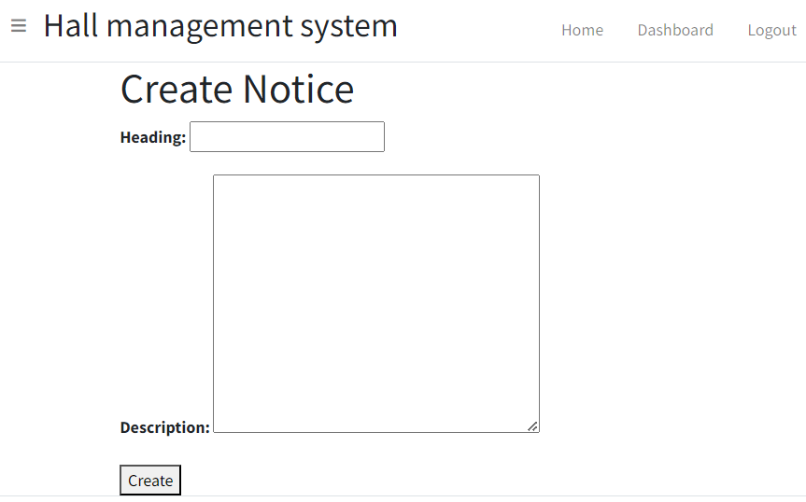
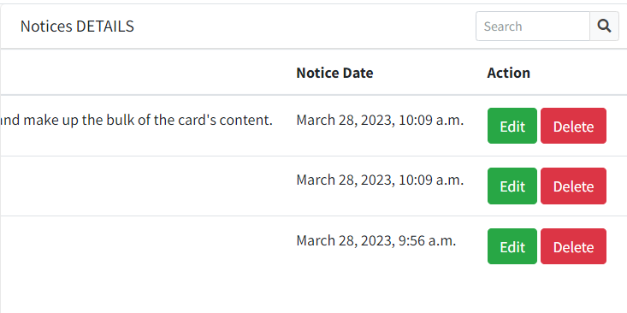
Login as Admin(cont..)
Admin can create a notice when admin want to tell student about annual sports program, any fresher program .
Admin can manage notice by edit notice when admin make some mistake to create a notice.
Then admin can delete a notice after the program when the notice don’t need.

Slide 29
Thank you!
Do you have any questions?

